Slide 1
Leadership

Slide 2
A Leadership Story:
A group of workers and their leaders are set a task
of clearing a road through a dense jungle on a remote island to get to the coast where an estuary provides
a perfect site for a port.
The leaders organise the labour into efficient units and monitor the distribution and use of capital assets – progress is excellent. The leaders continue to monitor and evaluate progress, making adjustments along the way to ensure the progress is maintained and efficiency increased wherever possible.
Then, one day amidst all the hustle and bustle and activity, one person climbs up a nearby tree. The person surveys the scene from the top of the tree.

Slide 3
A Leadership Story:
And shouts down to the assembled group below…
“Wrong Way!”
(Story adapted from Stephen Covey (2004) “The Seven Habits of Highly Effective People” Simon & Schuster).
“Management is doing things right, leadership is doing the right things”
(Warren Bennis and Peter Drucker)

Slide 4
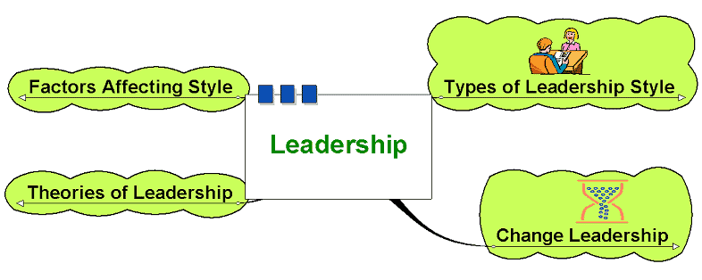
Leadership

Slide 5
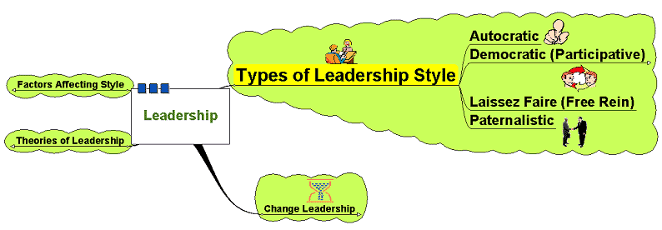
Types of Leadership Style

Slide 6
Types of Leadership Style
Autocratic:
  Leader makes decisions without reference to anyone else
  High degree of dependency on the leader
  Can create de-motivation and alienation
  of staff
  May be valuable in some types of business where decisions need to be made quickly and decisively

Slide 7
Types of Leadership Style
Democratic:
Encourages decision making
from different perspectives – leadership may be emphasised throughout
the organisation
  Consultative: process of consultation before decisions are taken
  Persuasive: Leader takes decision and seeks to persuade others that the decision
  is correct

Slide 8
Types of Leadership Style
Democratic:
  May help motivation and involvement
  Workers feel ownership of the firm and its ideas
  Improves the sharing of ideas
  and experiences within the business
  Can delay decision making

Slide 9
Types of Leadership Style
Laissez-Faire:
  ‘Let it be’ – the leadership responsibilities
  are shared by all
  Can be very useful in businesses
  where creative ideas are important
  Can be highly motivational,
  as people have control over their working life
  Can make coordination and decision making
  time-consuming and lacking in overall direction
  Relies on good team work
  Relies on good interpersonal relations

Slide 10
Types of Leadership Style
Paternalistic:
Leader acts as a ‘father figure’
Paternalistic leader makes decision but may consult
Believes in the need to support staff

Slide 11
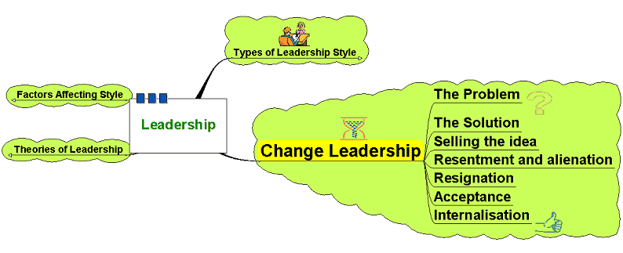
Change Leadership

Slide 12
Change Leadership
Leaders need to be aware of how change impacts on workers:
Series of self-esteem states identified by Adams et al and cited by Garrett
  Adams, J. Hayes, J. and Hopson, B.(eds) (1976) Transition: understanding and managing change personal change London, Martin Robertson
  Garrett, V. (1997) Managing Change in School leadership for the 21st century Brett Davies and Linda Ellison, London, Routledge

Slide 13
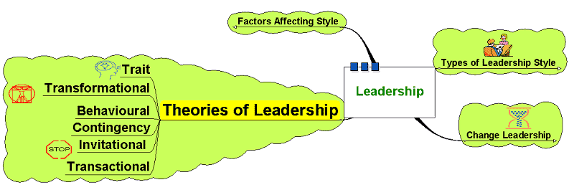
Theories of Leadership

Slide 14
Theories of Leadership
Trait theories:
Is there a set of characteristics
that determine a good leader?
  Personality?
  Dominance and personal presence?
  Charisma?
  Self confidence?
  Achievement?
  Ability to formulate a clear vision?

Slide 15
Theories of Leadership
Trait theories:
  Are such characteristics
  inherently gender biased?
  Do such characteristics
  produce good leaders?
  Is leadership more than
  just bringing about change?
  Does this imply that leaders are born not bred?

Slide 16
Theories of Leadership
Behavioural:
Imply that leaders can be trained – focus on the way of doing things
  Structure based behavioural theories – focus on the leader instituting structures – task orientated
  Relationship based behavioural theories – focus on the development and maintenance of relationships – process orientated

Slide 17
Theories of Leadership
Contingency Theories:
Leadership as being more flexible – different leadership styles used at different times depending on the circumstance.
Suggests leadership is not a fixed series of characteristics that can be transposed into different contexts

Slide 18
Theories of Leadership
May depend on:
  Type of staff
  History of the business
  Culture of the business
  Quality of the relationships
  Nature of the changes needed
  Accepted norms within the institution

Slide 19
Theories of Leadership
Transformational:
  Widespread changes
  to a business or organisation
Requires:
  Long term strategic planning
  Clear objectives
  Clear vision
  Leading by example – walk the walk
  Efficiency of systems and processes

Slide 20
Theories of Leadership
Invitational Leadership:
  Improving the atmosphere and message sent out by the organisation
  Focus on reducing negative messages
  sent out through the everyday actions of the business both externally and, crucially, internally
  Review internal processes to reduce these
  Build relationships and sense of belonging and identity with the organisation –
  that gets communicated to customers, etc.

Slide 21
Theories of Leadership
Transactional Theories:
  Focus on the management
  of the organisation
  Focus on procedures and efficiency
  Focus on working to rules
  and contracts
  Managing current issues
  and problems

Slide 22
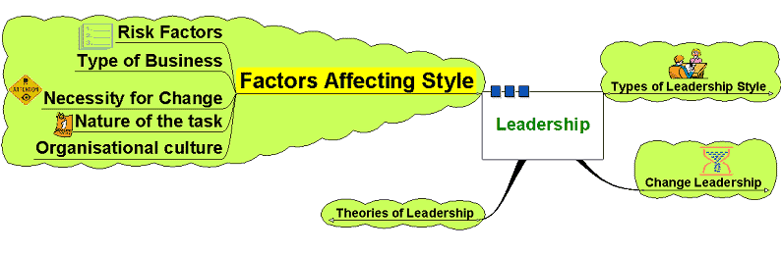
Factors Affecting Style

Slide 23
Factors Affecting Style
Leadership style may be dependent
on various factors:
  Risk - decision making and change initiatives
  based on degree of risk involved
  Type of business – creative business
  or supply driven?
  How important change is –
  change for change’s sake?
  Organisational culture – may be long embedded
  and difficult to change
  Nature of the task – needing cooperation? Direction? Structure?

